Slide 1
We’re separate because...
View in PRESENTATION view to listen to audio with slides
We ‘re on a journey of faith. . .

Slide 2
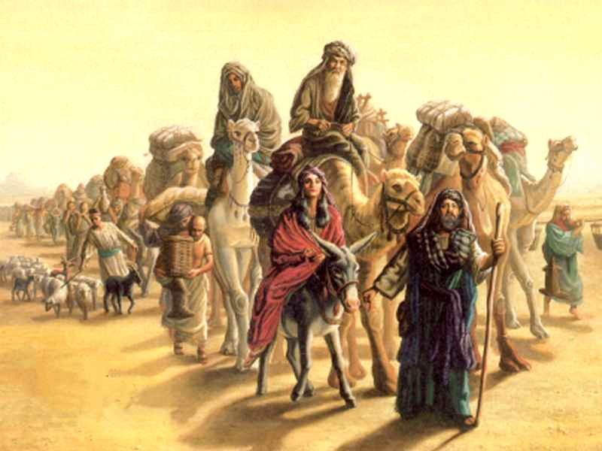
By Faith. . .
By faith Abraham, when called to go to a place he would later receive as his inheritance, obeyed and went, even though he did not know where he was going.
Hebrews 11:8

Slide 3
Revisiting last topic. . .
The Ladder of Trust. . .
Rung 1 – Trusting means Obeying
Rung 2 – Trusting that God will provide
Trust & Faith are synonymous

Slide 4
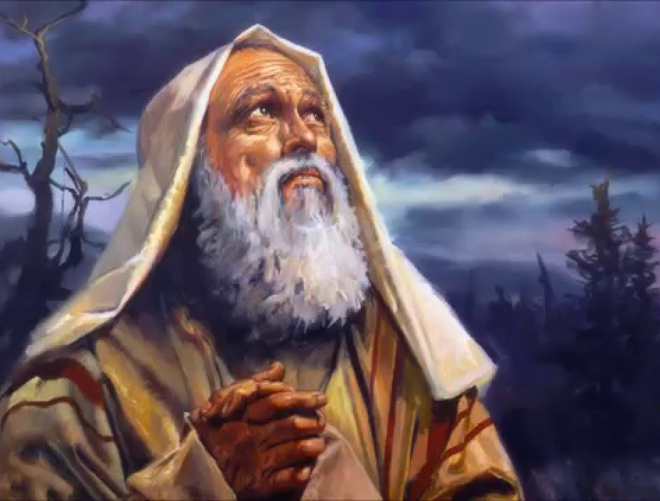
The first call. . .
Picture Abram?
What words would describe him?

Slide 5
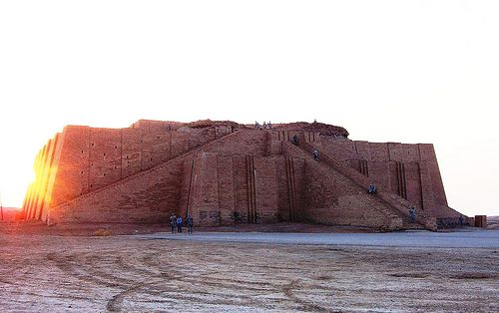
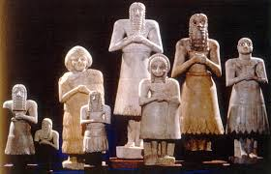
Terah – the story begins. . .
Terah took his son Abram, his grandson Lot son of Haran, and his daughter-in-law Sarai, the wife of his son Abram, and together they set out from Ur of the Chaldeans to go to Canaan. But when they came to Harran, they settled there.
(Genesis 11:31)

Slide 6
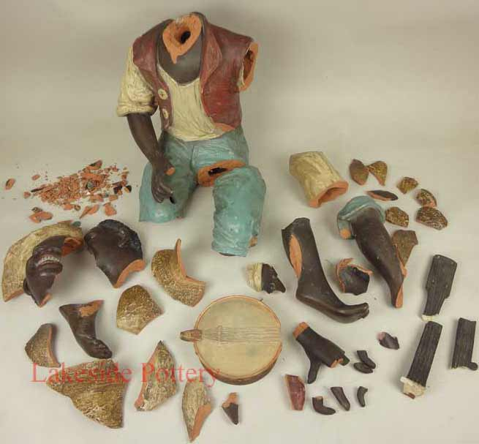
Family Background. . .
‘Long ago your ancestors, including Terah the father of Abraham and Nahor, lived beyond the Euphrates River and worshiped other gods.
Joshua 24:2
Now you have gone off because you longed to return to your father’s household. But why did you steal my gods?”
Genesis 31:30
Tradition 1 – Idol Maker
Tradition 2 – Idol breaker

Slide 7
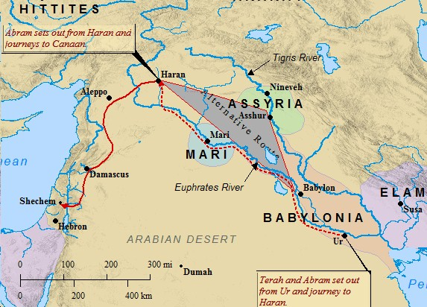
Leaving Haran. . .
The Lord had said to Abram, “Go from your country, your people and your father’s household to the land I will show you.
So Abram went, as the Lord had told him; and Lot went with him. Abram was seventy-five years old when he set out from Harran.
Genesis 12:1, 4

Slide 8
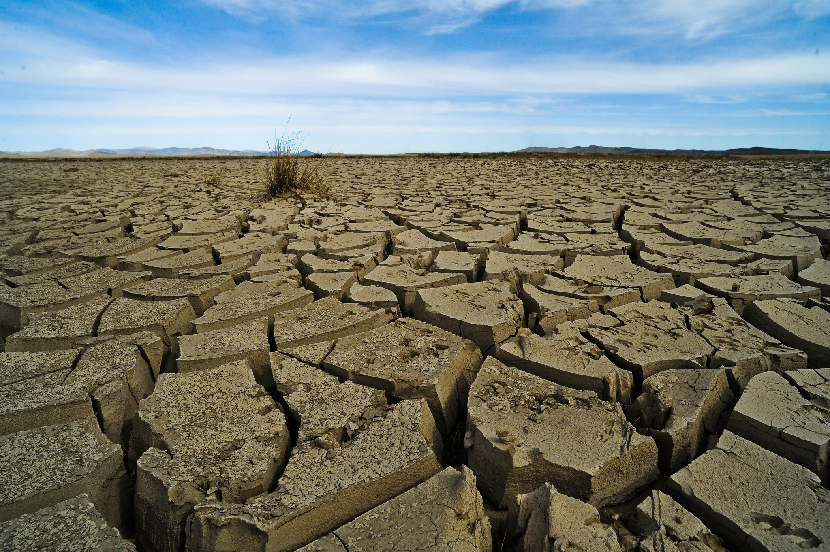
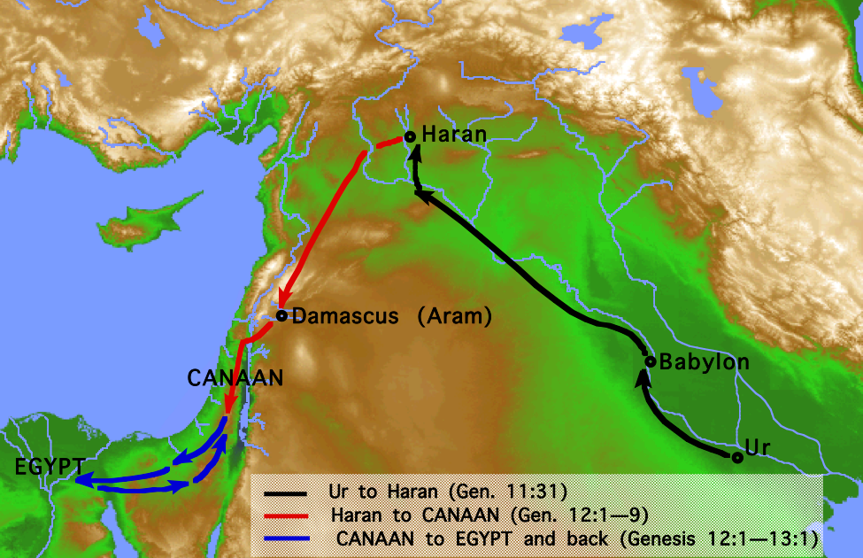
Meeting challenges. . .
Now there was a famine in the land, and Abram went down to Egypt to live there for a while because the famine was severe.
Genesis 12:10
Notes:
Genesis 12:4 states Abram was 75 when he left Harran.
Gen 16:16 states Abram 86 when Ishmael was born
16:3 has Sarai giving Hagar to Abram 10 years after they arrived back to Canaan from Egypt
Thus – the total time from leaving Haran to returning to Canaan (including stay in Egypt) was not more than 1 year – more likely 3 months.

Slide 9
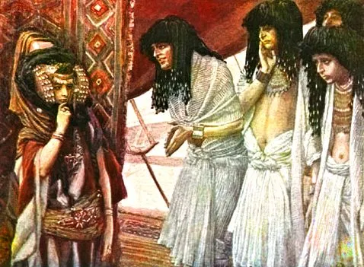
Failing the test. . .
As he was about to enter Egypt, he said to his wife Sarai, “I know what a beautiful woman you are. ¹² When the Egyptians see you, they will say, ‘This is his wife.’ Then they will kill me but will let you live. ¹³ Say you are my sister, so that I will be treated well for your sake and my life will be spared because of you.”
Genesis 12:11-13
James Tissot

Slide 10
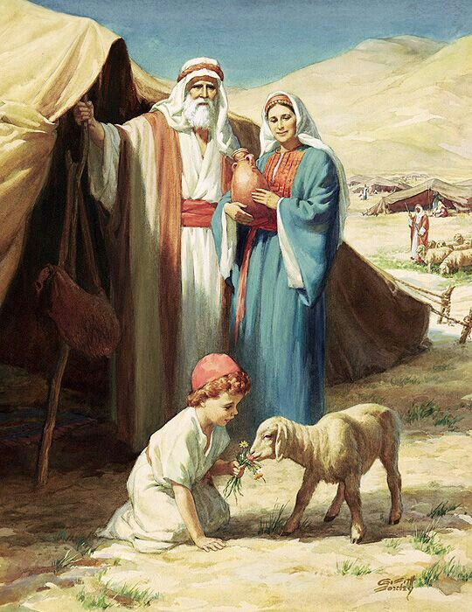
Deferred Dreams. . .
That is why a man leaves his father and mother and is united to his wife, and they become one flesh.
Genesis 2:24
Ready to be a Godly husband?
Ready to be a Godly Father?

Slide 11
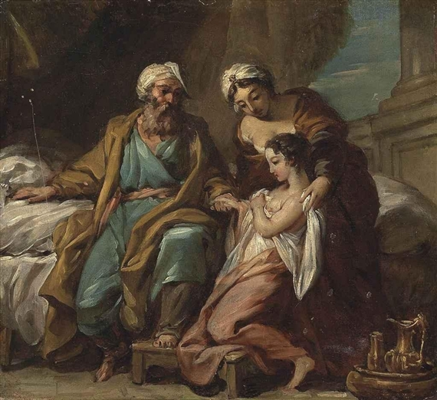
Symmetry. . .
He treated Abram well for her sake, and Abram acquired sheep and cattle, male and female donkeys, male and female servants, and camels.
Genesis 12:16
Abram had become very wealthy in livestock and in silver and gold.
Genesis 13:2
Now Sarai, Abram’s wife, had borne him no children. But she had an Egyptian slave named Hagar; so she said to Abram, “The Lord has kept me from having children. Go, sleep with my slave; perhaps I can build a family through her.”
Genesis 16:1-2

Slide 12
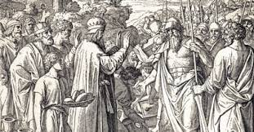
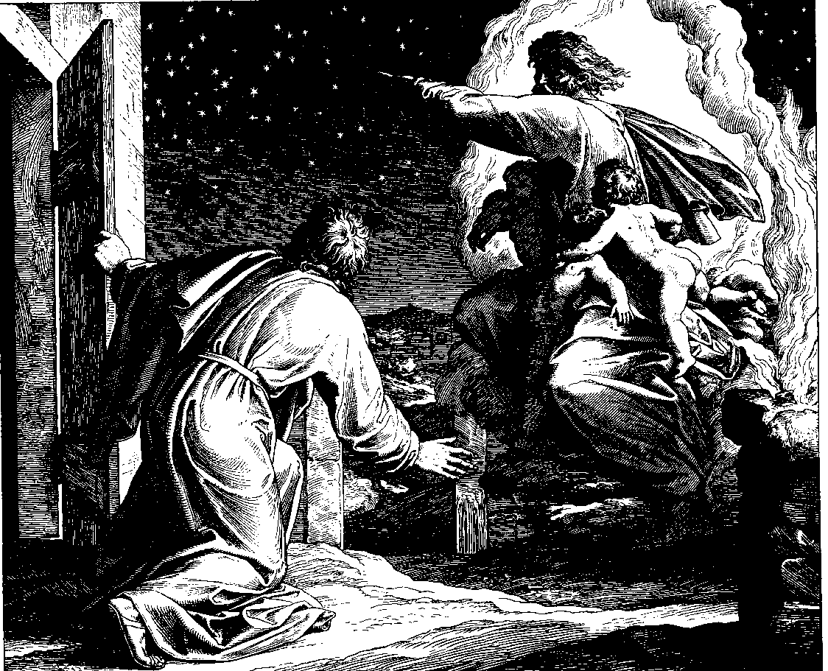
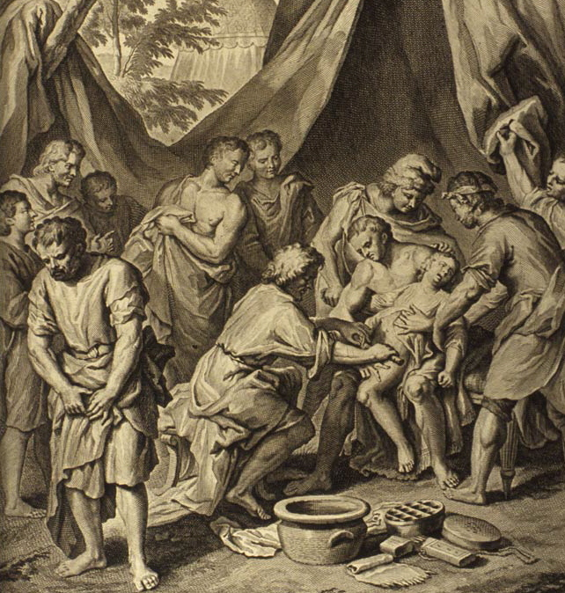
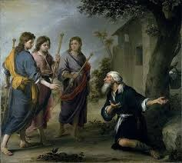
The Journey continues. . .
Circumcision
Rescue of Lot
3 Visitors
Covenant renewed

Slide 13
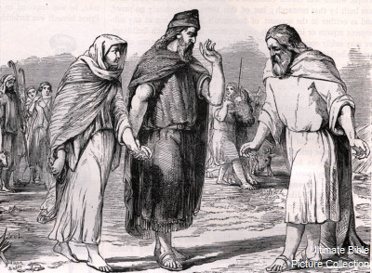
Abraham tries again. . .
For a while he stayed in Gerar, and there Abraham said of his wife Sarah, “She is my sister.” Then Abimelek king of Gerar sent for Sarah and took her.
Genesis 20:1, 2
³ But God came to Abimelek in a dream one night and said to him, “You are as good as dead because of the woman you have taken; she is a married woman.”
¹⁵ And Abimelek said, “My land is before you; live wherever you like.”

Slide 14
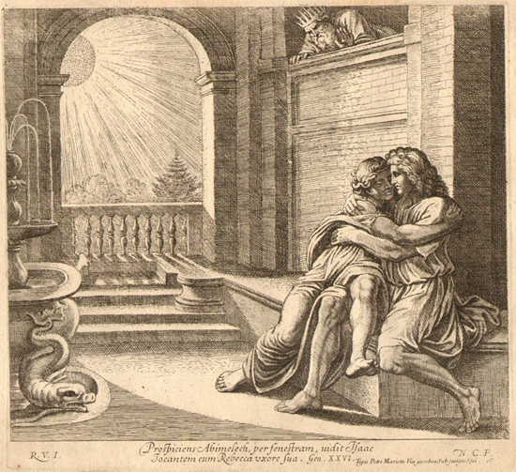
Isaac – Similarities. . .
Now there was a famine in the land—besides the previous famine in Abraham’s time—and Isaac went to Abimelek king of the Philistines in Gerar.
Genesis 26:1
When the men of that place asked him about his wife, he said, “She is my sister,” because he was afraid to say, “She is my wife.” He thought, “The men of this place might kill me on account of Rebekah, because she is beautiful.”
Genesis 26:7

Slide 15
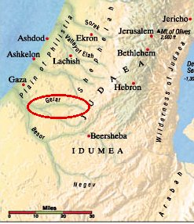
Isaac - Differences
The Lord appeared to Isaac and said, “Do not go down to Egypt; live in the land where I tell you to live. Stay in this land for a while, and I will be with you and will bless you.
Genesis 26:2, 3
So Isaac stayed in Gerar.
Genesis 26:6

Slide 16
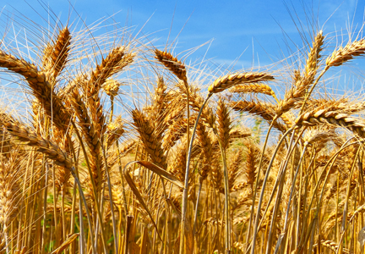
Isaac - Differences
Isaac planted crops in that land and the same year reaped a hundredfold, because the Lord blessed him. The man became rich, and his wealth continued to grow until he became very wealthy. He had so many flocks and herds and servants that the Philistines envied him.
Genesis 26:12-14
Then Abimelek said to Isaac, “Move away from us; you have become too powerful for us.”
Genesis 26:16

Slide 17
The Ladder of Trust / Faith. . .
Rung 1 – Trusting means Obeying
Rung 2 – Trusting that God will provide
Where would Abraham stand on this ladder?
What about Isaac?

Slide 18
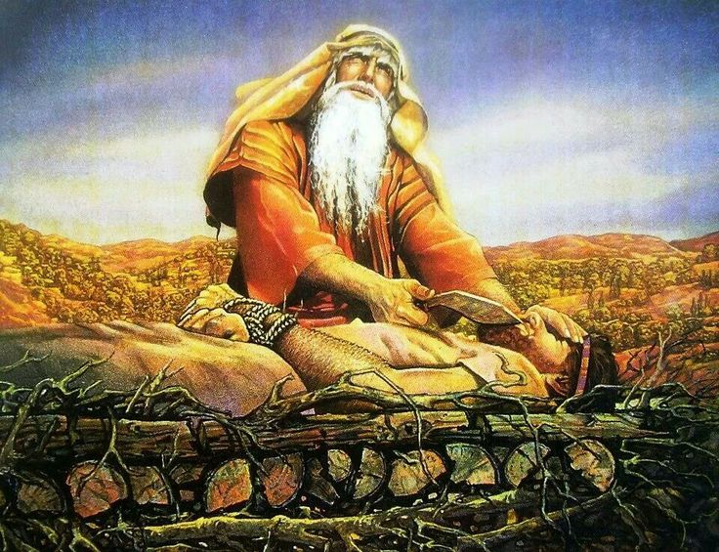
The other end of the journey. . .
Then God said, “Take your son, your only son, whom you love—Isaac—and go to the region of Moriah. Sacrifice him there as a burnt offering on a mountain I will show you.”
Genesis 22:2
Abraham answered, “God himself will provide. . .”
Genesis 22:8

Slide 19
The Ladder of Trust / Faith. . .
Rung 1 – Trusting means Obeying
Rung 2 – Trusting that God will provide
Where would Abraham stand on this ladder?
At the start of his journey?
At the close of his journey?
What about Isaac?
What about us?

Slide 20
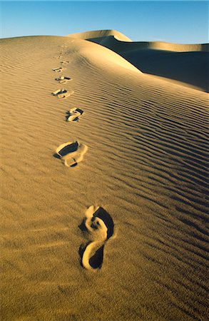
Conclusions. . .
We are on a journey
We still make mistakes
Trust/Faith means obeying
Trust/Faith means waiting for provision.
Trust/Faith means learning – as Abraham did.

